Slide 1
The Battle of Neighborhoods
- Irfat Kapde
IBM Capstone by Coursera

Slide 2
Selecting neighborhood in Scarborough, Toronto:
This project aims to create an analysis of features for people migrating to Scarborough to search for the best neighborhood as a comparative analysis between neighborhoods.
The features include median housing price and better school according to ratings, crime rates of that particular area, road connectivity, weather conditions, good management for emergency, water resources both fresh and waste water and excrement conveyed in sewers and recreational facilities.

Slide 3
Data
Data Link: https://en.wikipedia.org/wiki/List_of_postal_codes_of_Canada:_M
Scarborough dataset which we scrapped from wikipedia on Week 3. Dataset consisting of latitude and longitude, zip codes.
Foursquare API Data:
We will need data about different venues in different neighborhoods of that specific borough. In order to gain that information we will use "Foursquare" locational information.

Slide 4
Methodology
To compare the similarities of two cities, we decided to explore neighborhoods, segment them, and group them into clusters to find similar neighborhoods in a big city like New York and Toronto. To be able to do that, we need to cluster data which is a form of unsupervised machine learning: k-means clustering algorithm.

Slide 5
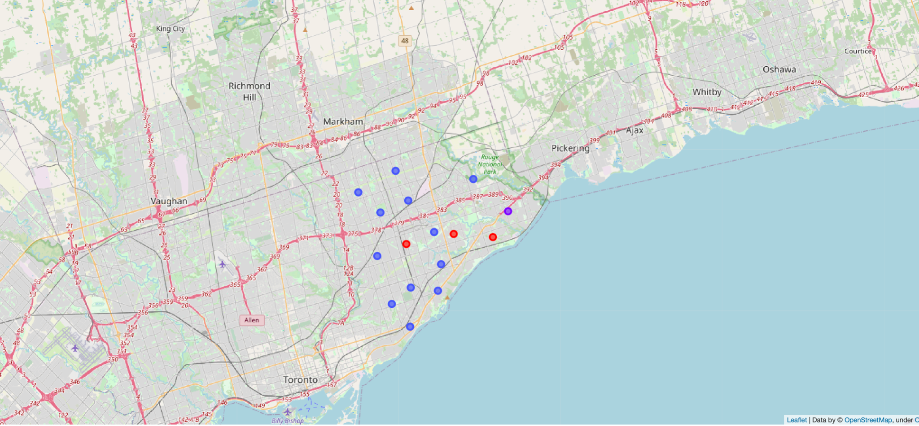

Slide 6
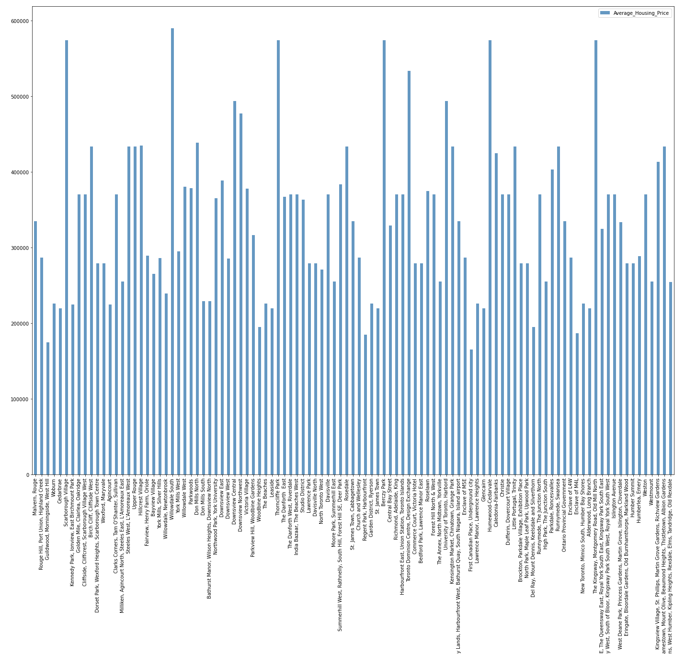
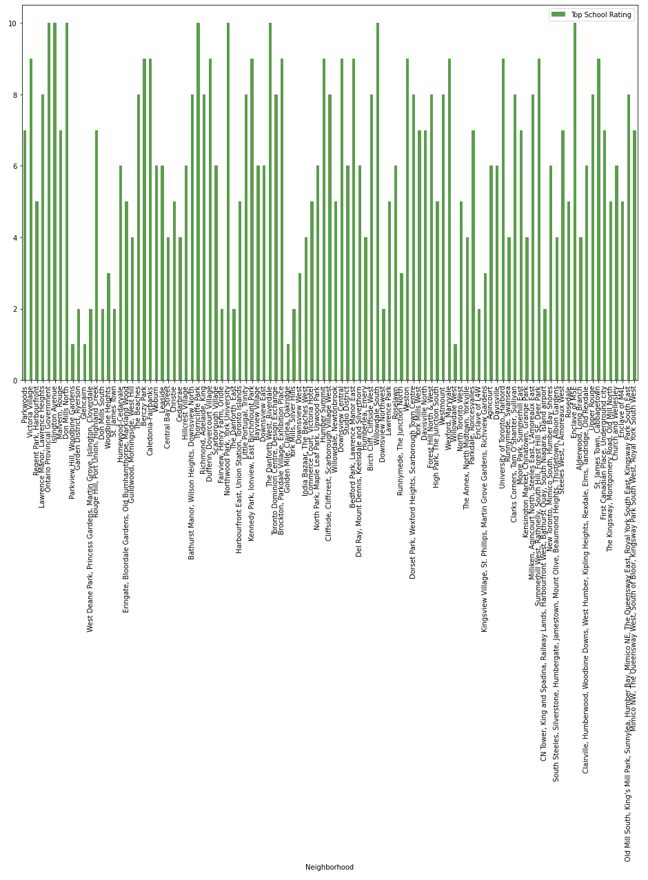

Slide 7
Conclusion
Using the k-means cluster algorithm, the neighborhood was separated into 10 different clusters and for 103 different latitude and longitudes from the dataset, which have similar neighborhoods around them.
Using the charts above results presented to a particular neighborhood based on average house prices and school rating have been made.

